Slide 1
Rational Emotive Behavior Therapy in the Words of Epictetus
Walter J. Matweychuk, Ph.D.
REBTDoctor.com
Notes:
Good morning and let me begin by thank Don, and all the people who are helping him today, for this opportunity to speak on Rational Emotive Behavior Therapy

Slide 2
Thank You Don & Your team
Thank you Don Robertson and all the other Stoics who helped bring us together today.
Your passion for the dissemination of Stoicism is truly inspiring.

Slide 3
My Journey to Stoicism
I am a clinical psychologist trained in Rational Emotive Behavior Therapy by Dr. Albert Ellis
Ellis always said REBT was an amalgamation of ancient and modern philosophy
REBT borrows heavily from Stoicism
Given that REBT’s roots lie in Stoicism I set out to deepen my appreciation of REBT by studying Stoicism
Notes:
0. Discuss your background and how you came to be interested in Stoicism
Two goals for my presentation:
To show you how many of the roots of REBT lie Stoicism and to accomplish this I will use the words of Epictetus throughout this presentation
To introduce you to the fundamental concepts of REBT
To show you that REBT is a tool that helps people implement Stoic thinking by attacking the attitudes block implementation and teaching attitudes that facilitate implementation of Stoic thinking

Slide 4
Stoicism & REBT as Real World Therapies
In 1955 REBT was a game changing approach to psychotherapy
Unlike other cognitive behavior therapies that developed in academia and followed it REBT was developed in a real world clinical setting
Ellis turned to a real world practical philosophy to develop his new approach because he was a practitioner and needed to help people with multiple clinical problems many of which were quite challenging in nature
Over the six decades of his career, Ellis had over 180,000 hours of face to face clinical time with patients and wisely turned to philosophy both for answers and for his own personal strength, meaning and happiness

Slide 5
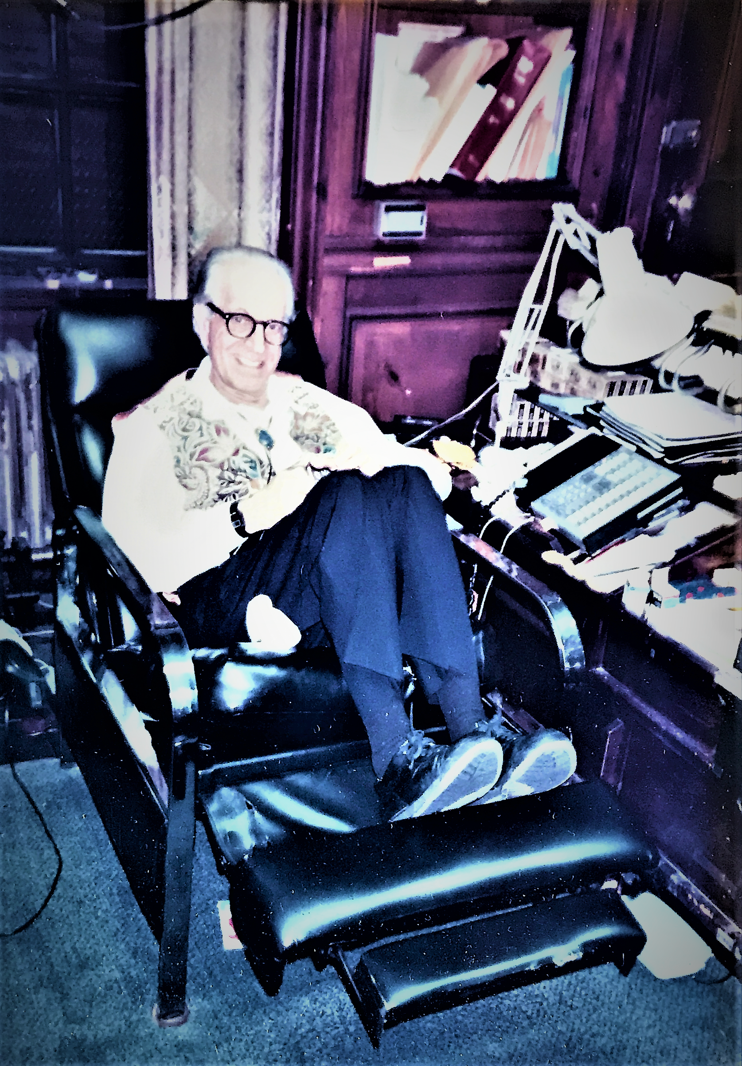
Albert Ellis, Ph.D.
September 27, 1913 – July 24, 2007

Slide 6
How REBT relates to those interested in Stoicism
If you practice Stoicism you will find much to like and use in REBT
Because REBT is a self-help form of evidence-based cognitive behavior therapy and a philosophy which largely overlaps with Stoicism
Therefore, it can assist you in implementing the core principles of Stoicism to problems of modern day living
The words of Epictetus in this presentation will serve to introduce the core principles of REBT and show you how REBT links back to and stands on the shoulders of Stoicism

Slide 7
In the words of Epictetus
“It is not events that disturb people, it is their judgments concerning them.”
Enchiridion 5
Notes:
This quote was often use by Ellis to introduce his work in print or during lectures

Slide 8
In the words of Epictetus
“So make a practice at once of saying to every strong impression: ‘An impression is all you are, not the source of the impression.’ Then test and assess it with your criteria, but one primarily: ask, ‘Is this something that is, or is not, in my control?’ And if it’s not one of the things that you control, be ready with the reaction, ‘Then it’s none of my concern.’”
Enchiridion 1(5)
Notes:
In REBT we teach people to focus on controlling what they can control which is their attitudes about what happens to them.
Ellis used to teach that people spend time trying to change other people instead of changing what was very much under their direct control which was themselves and their attitudes and reactions towards other people and adversity

Slide 9
Emotional Disturbance Defined & Not Caused by Adversity
Consistent with Stoicism REBT argues that adversity in and of itself is insufficient to produce maladaptive, self-defeating emotional disturbance
In REBT emotional disturbance is defined as emotional and behavioral reactions that are self-defeating, unhealthy and undermine our primary goals of survival and happiness
Our goals and values are subsumed under these two overarching goals
Notes:
As in Stoicism – REBT teaches adversity in and of itself is insufficient to produce emotional disturbance…
Define emotional disturbance:
Self-defeating
Undermines our effort to survive and experience happiness

Slide 10
REBT’s ABC Model of Disturbance
A = Adversity
B = Basic Attitudes about adversity (i.e. rigid and extreme attitudes)
C = Emotional consequences
Note: Before REBT therapy people will often wrongly believe that their emotional upset is a result of adversity (e.g. anger) suggesting that A (Adversity) directly leads to C (emotional consequence).
Notes:
Explain the ABC heuristic
Ellis introduced the ABC model of emotion which is a useful framework for showing people that adversity in and of itself is insufficient to cause emotional disturbance.

Slide 11
Negative Emotion Can Be healthy & Is Part of Life
Healthy negative emotions are not to be erased or eliminated
Experience HNEs as they are good and self-helping and result when our desires are not met; they are motivating and can lead to productive action
Basic Eight Healthy Negative Emotions
  Concern
  Sadness
  Remorse
  Disappointment
  Sorrow
  Productive Anger
  Relationship preserving Jealousy
  Productive, motivating Envy
Notes:
Consistent with Stoicism negative emotion is part of the human condition and is not to be eliminated
Negative emotions can be healthy, self-helping and motivate us to change what we can change

Slide 12
healthy & Unhealthy negative emotions
Healthy & Self-Helping
Unhealthy & Self-Defeating
  Concern
  Sadness
  Remorse
  Disappointment
  Sorrow
  Productive Anger
  Relationship preserving Jealousy
  Productive, motivating Envy
  Anxiety
  Depression
  Guilt
  Shame
  Hurt
  Unproductive anger
  Relationship interfering jealousy
  Unproductive, self-disturbing envy
Notes:
In REBT we have two categories of negative emotion
Discuss the limitations of the English language and the difference between unhealthy anger, jealousy and envy and healthy anger, jealousy, and anger

Slide 13
Characteristics of Unhealthy Negative Emotions
Essentially are self-defeating
Interfere with living well with what cannot be changed
Undermine our effort to improve things
Can lead to excessive behaviors (e.g. aggressive behavior)
Often lead to avoidance & escape behavior that is unhealthy (e.g. excessive use of alcohol)
Prevents having some degree of happiness in the presence of unchangeable adversity

Slide 14
Characteristics of Healthy Negative Emotions
Give us feedback that something we value and want is not occurring
Motivate us to creatively change what can be changed to get more of what we want and less of what we do not want
Do not undermine our efforts towards our goals
Allow us to live well with adversity when it cannot be changed
Allow us to have some happiness in the presence of adversity in our lives

Slide 15
Examples of healthy & Unhealthy negative emotions at Work
Healthy & Self-Helping
Unhealthy & Self-Defeating
  Concern
  (frees one for action; calculated risk taking & facilitates creativity)
  Productive Anger
  (allows for acting in one’s long-term best interest)
  Productive, motivating Envy
  (leads to modeling and mentoring in the work place)
  Anxiety
  (leads to procrastination; lack of creativity or playing it too safe)
  Unproductive Anger
  (interferes with acting in one’s long-term best interest)
  Unproductive, self-disturbing Envy
  (leads to undermining a colleague or discrediting their reputation; thinking obsessively about how to get what one covets)
Notes:
In REBT we have two categories of negative emotion
Discuss the limitations of the English language and the difference between unhealthy anger, and envy and healthy anger, and envy

Slide 16
In the words of Epictetus
“Remember that you are an actor in a play, the nature of which is up to the director to decide. If he wants the play to be short, it will be short, if he wants it long, it will be long. And if he casts you as one of the poor, or as a cripple, as a king or a commoner – whatever the role assigned, the accomplished actor will accept and perform it with impartial skill. But the assignment of roles belongs to another.”
Enchiridion 17
Notes:
Epictetus once again appeals us to go with and adapt well to whatever adversity we are assigned.
I tell my patients to strive to use REBT to live well with the adversities assigned in order to change what we can change and have some degree of happiness with whatever we cannot change.

Slide 17
In the words of Epictetus
“Don’t hope that events will turn out the way you want, welcome events in whichever way they happen: this is the path to peace.”
Enchiridion 8

Slide 18
REBT’s View of Acceptance
Acknowledge that something exists which is against our goals & values
Acknowledge that it would be preferable for this particular reality not to exist
Acknowledge that it does not logically follow to conclude that the negative reality must not exist
With firm determination, change the negative existing conditions if they can be changed
Or firm determination, adjust constructively with conditions that cannot be changed

Slide 19
In the words of Epictetus
“It is not events that disturb people, it is their judgements concerning them. Death, for example, is nothing frightening, otherwise it would have frightened Socrates. But the judgement that death is frightening – now that is something to be afraid of. So when we are frustrated, angry or unhappy, never hold anyone except ourselves – that is, our judgements – accountable.”
Enchiridion 5
Notes:
So here Epictetus advocates holding ourselves accountable by seeing the profound impact our judgments have on our emotional reactions.

Slide 20
REBT’s Principle of Emotional Responsibility
We largely disturb ourselves about adversity
Emotional disturbance does not happen to us
We are not victims of adversity so much as victims of our rigid and extreme attitudes about what other people do to us and what fate throws our way
We nearly always have a degree of emotional choice
Notes:
Elegant or succinct theory

Slide 21
Humans Disturb themselves
Humans help adversity along by holding rigid and extreme attitudes about adversity
Humans create their emotional disturbance; we disturb ourselves
REBT’s Principle of Emotional Responsibility – we are responsible for our own disturbance
I often directly ask people
  “How are you angering yourself about your colleague’s misbehavior?”
  “How are you depressing yourself about being passed over for the promotion?”
  “What attitude would help you to respond productively to this adversity & live well with it?”

Slide 22
In the Words of Dryden
“It is not events that disturb people, it is their rigid and extreme attitudes concerning them.”
Windy Dryden, Ph.D.
(Leading REBT Practitioner)
Notes:
We in REBT focus on a type of impression or cognitions, our rigid and extreme attitudes

Slide 23
In the Words of Epictetus
“Remember, it is not enough to be hit or insulted to be harmed, you must believe you are being harmed. If someone succeeds in provoking you, realize that your mind is complicit in the provocation…”
Enchiridion 20

Slide 24
REBT’s ABC Model of Disturbance
A = Adversity
B = Basic Attitudes about adversity (i.e. rigid and extreme attitudes)
C = Emotional consequences
Note: Before REBT therapy people often have the attitude “My colleague made me angry. He absolutely should cooperate with me on this project!” suggesting that A (Adversity) directly leads to C (emotional consequence).

Slide 25
Adapting to Adversity &
Having a Tough-Minded stance
To adapt & help ourselves in the face of adversity one can relinquish rigid & extreme attitudes and adopt flexible & non-extreme attitudes towards adversity
Example: “I really wish my colleague would cooperate with me on this project but he does NOT ABSOLUTELY HAVE to cooperate with me. I will choose a healthy attitude towards his uncooperative behavior and then take steps to influence him to cooperate to whatever extent I can.”
This is a flexible attitude towards a negative state of affairs and will lead to healthy, productive negative feelings of disappointment, sorrow, concern and\or productive anger.

Slide 26
the origins of Disturbance & the Human Condition
All humans are born & reared to hold to a greater or lesser extent rigid & extreme attitudes
Also born & reared to hold flexible & non-extreme attitudes
Irrational, self-defeating attitudes & rational, self-helping attitudes are part of the human condition and are rooted in our biology
Notes:
Born and reared to think rigidly and extremely
Good news is that we also are born to think rationally
People will vary in the relative balance between the inclination they have to hold rigid and extreme attitudes relative to the inclination they have to feel flexible and non-extreme attitudes
So irrational thinking in the form of holding rigid and extreme attitudes is part of the human condition

Slide 27
Human Limitations & the Human Condition
Note: we will never completely eliminate the irrationality that lurks within us
We can greatly reduce the intensity, frequency, & duration with which it reveals itself in our emotional lives
We will remain fallible, humans despite the potential for significant growth and self-actualization

Slide 28
In the words of Epictetus
“We must undergo a hard winter training and not rush into things for which we haven’t prepared.”
Discourses 1.2.32

Slide 29
Work And Practice required Due to our Biological Tendencies
Humans can train themselves, through work and practice, to detect, challenge & relinquish rigid and extreme attitudes
Humans through deliberate effort can adopt healthy, self-helping flexible & non-extreme attitudes
Humans need to remain on guard against backsliding

Slide 30
Psychotherapy as Psychoeducation
REBT is both a philosophy & a psychotherapy
As a therapy it teaches people to question & relinquish their rigid & extreme attitudes and to adopt flexible & non-extreme attitudes
As a philosophy it suggests values to live by

Slide 31
In the Words of Epictetus
“Learning that does not lead to action is useless.”
Discourses 1.29.35

Slide 32
On Making Therapeutic Progress
Discuss & reflect on the validity & functional value of rigid and extreme attitudes in session
Continue the psychoeducation at home through reading, audio presentations (go to REBTDoctor.com)
At home forcefully disputing your irrational attitudes
Practice through repetition healthy, rational attitudes
Most importantly act on those rational attitudes; live in harmony with them, walk the talk!

Slide 33
REBT’s Four Irrational Attitudes
The theory holds there are four attitudes responsible for disturbance
  One attitude is primary – the rigid attitude at the core of disturbance
  Three derivative extreme attitudes that come from the rigid attitude

Slide 34
Rigid Attitude at the Core of Emotional Disturbance
Ellis humorously named this core process “musturbation”
Also referred to as Demandingness
Absolutistic, rigid, dogmatic, anti-scientific in nature
Typically expressed with words like:
  Must
  Absolutely should
  Have to (in the absolute sense)
  Need to (in the absolute sense)

Slide 35
In the Words of Ellis
“Assume that just about all your dogmatic musts fall under three major headings.”
How to Make Yourself Happy and Remarkably Less Disturbable, p. 13

Slide 36
Three Musts In The words of Ellis
“I absolutely must perform well on important projects and be approved of by significant people or else I am an inadequate and unlovable person!”
“Other people, particularly those I have cared for and treated well, absolutely must treat me kindly and fairly, or else they are rotten individuals who deserve to suffer!”
“The conditions under which I live absolutely must be easy, unfrustrating, predictable, secure and enjoyable or else the world’s an awful place, I can’t stand it, and I’ll never be happy!”

Slide 37
Three Extreme Derivative Attitudes
Three extreme irrational processes:
  It is awful, terrible, the end of the world (Awfulizing)
  It is intolerable, unbearable, I cannot stand it (Discomfort Disturbance)
  The Devaluation of self, others, life (Disturbance related to Human Worth)

Slide 38
Flexible Attitudes AT The core of emotional health
Flexible, preferential, empirically supported attitudes expressed with words like
  want
  wish
  desire
  prefer
And ended with acknowledgement that I do not have to have that which I want, wish, desire or prefer
Example: “I want & prefer my colleague's cooperation with this project, but I do not absolutely have to have his cooperation.”

Slide 39
Non-Extreme Attitudes Derive from Flexible Attitude
It is bad, undesirable, inconvenient, etc. but not awful, terrible or the end of the world…
It is uncomfortable but not unbearable, intolerable, or something I cannot survive and live with…
People do bad deeds & are a mix of good, neutral and bad characteristics. All people are complex, fallible humans in a state of flux and a bad action or characteristic does not determine the person’s worth as a human

Slide 40
Bottom line of REBT
REBT encourages the adoption of
  Unconditional self-acceptance (USA)
  Unconditional other-acceptance (UOA)
  Unconditional life-acceptance (ULA)
Notes:
As you can see when REBT teaches people to develop unconditional life-acceptance they are teaching people to live in a way consistent with Epictetus’s previous quote "Don't hope that events will turn out the way you want, welcome events in whichever way they happen: This is the path to peace.”
Going back to rigid attitudes the REBT therapist regularly disputes the irrational attitude “That life should not be so difficult, unfair, complex, etc.” which thereby helps the client in the words of Epictetus “welcome what happens...” and to thereby find peace.

Slide 41
In the Words of Epictetus
“If you are ever tempted to look for outside approval, realize that you have compromised your integrity. So be satisfied just being a philosopher, and if you need a witness in addition, be your own; and you will be all the witness you could desire.”
Enchiridion 23
Notes:
Here we see perhaps Ellis’s inspiration for the concept of unconditional self-acceptance which we teach by attacking rigid and extreme attitudes often help by clients such as:
I need the approval of significant others.
My human worth is related to how well accepted I am by others.
Instead REBT advocates attitudes like: “I want the approval of significant others but I need it in order to accept myself. I am worthy independent of others acceptance and approval of me.”

Slide 42
In the Words of Epictetus
“We use labels like ‘thief’ and ‘robber’ in connection with them, but what do these words mean? They merely signify that people are confused about what is good and what is bad. So should we be angry with them, or should we pity them instead?”
Discourses I.18.13
Notes:
Other Acceptance

Slide 43
In the words of Epictetus
“Don’t hope that events will turn out the way you want, welcome events in whichever way they happen: This is the path to peace.”
Enchiridion 8

Slide 44
REBT’s philosophical Values
Self-interest (enlightened self-interest)
Social interest
Self-direction
High frustration and discomfort tolerance

Slide 45
REBT’s philosophical Values
Flexibility in thinking, open to change, unbigoted
Acceptance of Uncertainty
Commitment to creative and meaningful pursuits
Scientific thinking

Slide 46
ReBT’s Philosophical Values
Self, Other and Life Acceptance
Calculated Risk-taking
Long-range hedonism (hedonic calculus)
Nonutopianism & nonperfectionism related to self, others, and life
Self-responsibility for own emotional disturbance
(Principle of Emotional Responsibility)

Slide 47
In the words of Epictetus
“As with impressions generally, if you get an impression of something pleasurable, watch yourself so that you are not carried away with it. Take a minute and let the matter wait on you. Then reflect on both intervals of time: the time you will have to experience the pleasure, and the time after its enjoyment that you will beat yourself up over it. Contrast that with how happy and pleased you’ll be if you abstain. If the chance to do the deed presents itself, take extra care that you are not overcome by its seductiveness, pleasure and allure. Counter temptation by remembering how much better will be the knowledge that you resisted.”
Enchiridion 34
Notes:
Unfortunately time does not permit to show you quotes which support these 12 values
However, values 4 High frustration and discomfort tolerance AND value 10 Long-range hedonism are nicely taught by Epictetus in this somewhat lengthy quote
In REBT we teach the rational attitude that
Abstaining from the indulgence of a pleasurable act may be uncomfortable but is NOT unbearable. When it is worth it in the long run to forgo short-term pleasure for long-term gain REBT teaches a rational attitude that frees us to have greater pleasure or less pain in the long term
As you can see words of Epictetus support this value found within REBT

Slide 48
Your Take Home and My Wish
Consider adding REBT to your study of Stoicism
REBT will help you implement the teachings of Epictetus and other Stoic Philosophers
Like Stoicism, it is a tough-minded philosophy that holds up well when your worst nightmare or adversity occurs
This will help you as you strive to live virtuously as a fallible human in a challenging world
Notes:
We all are here because we want to get on and stay on a path to peace
REBT can help you do that
It is a well packaged
Easy to learn philosophical tool
Which will aid you in your practice of Stoicism

Slide 49
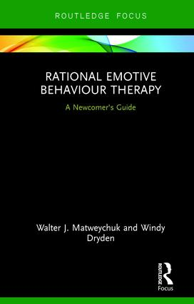
Rational Emotive Behavior Therapy – A Newcomer’s Guide

Slide 50
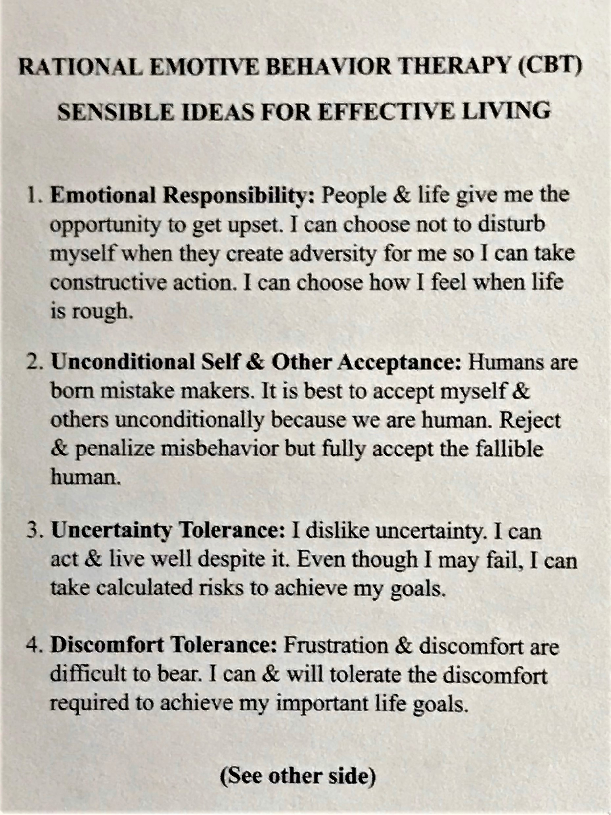
REBT Core Principles Wallet Cards

Slide 51
To Learn More About REBT
Write to REBTDoctor@gmail.com for this slide set if you wish a copy.
Visit REBTDoctor.com for access to audio and video on REBT
Suggested Reading:
  For Professionals: Rational Emotive Behavior Therapy – A Newcomer’s Guide
  (W. J. Matweychuk and W. Dryden)
  For Self-Help:
    How to Make Yourself Happy and Remarkably Less Disturbable (A. Ellis)
    How to Stubbornly Refuse to Miserable About Anything, Yes Anything! (A. Ellis)
    How to Control Your Anger Before It Controls You(A. Ellis)

